Slide 1
Unit 2
Planning and implementation of an IT Infrastructure Audit for compliance

Slide 2
Defining the scope for audit
1. What is audit ?
2. Why to perform audit ? (banking, college, financial audit)
The scope for audit – what audit will cover and what it will not cover.
3. The scope can be formed on particular products or services, locations, departments, individual projects, time periods, and even specific processes.

Slide 3
Defining the scope for audit
Let me give you some examples:
The audit will cover the manufacture of product A and B, but not the manufacture of product C.
The audit will cover head office plus the branches in New York, London, and Tokyo.
The audit will cover the work period from January through to June inclusively.
Without an effective scope, both the auditor and the auditee are unsure of the boundaries of the audit and time is often wasted through checking and verifying information that is not required (out of scope).

Slide 4
Defining the scope for audit
Audit scope V/s Audit criteria
Audit scope includes the time period of the audit, documents that are involved, physical location, organizational unit, and all the activities and the processes that will be conducted. It is the idea that deals with the depth of the audit process and how deep the auditor will dig in to get the relevant information. It is the extent and the boundary of the audit.
Whereas audit criteria can be termed as the set of policies, requirements, and procedures that are required for a successful audit. It can also be defined as the principle standards abiding in which the audit will be conducted.

Slide 5
Defining the scope for audit
Types of Audit
    Compliance Audit – internal and regular standards.
    Construction audit – cost incurd in construction project.
    Financial Audit – Analyze financial statement of an organization.
    Information system Audit – identify issue in IT system.
    Investigative Audit – investigate about inappropriate action taken place.
    Operational Audit - evaluation of the operational activities.
    Tax Audit – find out how much tax is paid as an organization.

Slide 6
Identifying critical requirements (essential conditions) for the audit
1.Establishing priority areas.
2. Identifying monitoring and continuous audit rules.
3. Determining the process' frequency.
4. Configuring continuous audit parameters.
5. Following up.
6. Communicating results.

Slide 7
Assessing IT security
Why to perform IT Security Risk assesment ?
    Reduction of Long-Term Costs
    Provides a Cybersecurity Risk Assessment Template for Future Assessments
    Better Organizational Knowledge
    Avoid Data Breaches
    Avoid Application Downtime.
    Data Loss

Slide 8
Assessing IT security
How to perform IT Security Risk assesment ?
You may want to start by auditing your data to answer the following questions:
What data do we collect?
How and where are we storing this data?
How do we protect and document the data?
How long do we keep data?
Who has access internally and externally to the data?
Is the place we are storing the data properly secured? Many breaches come from poorly configured S3 buckets, check your S3 permissions or someone else will.

Slide 9
Assessing IT security
Source : https://www.upguard.com/blog/cyber-security-risk-assessment
Steps to perform IT Security Risk assesment ?
  Determine Information Value
  Identify and Prioritize Assets
  Identify Cyber Threats
  Identify Vulnerabilities
  Analyze Controls and Implement New Controls
  Calculate the Likelihood and Impact of Various Scenarios on a Per-Year Basis
  Prioritize Risks Based on the Cost of Prevention Vs Information Value
  Document Results from Risk Assessment Reports

Slide 10
Obtaining Information (basics Methods to collect information)
Methods | Overall Purpose | Advantages | Challenges
questionnaires, surveys, checklists | when need to quickly and/or easily get lots of information from people in a non threatening way | -can complete anonymously -inexpensive to administer -easy to compare and analyze -administer to many people -can get lots of data -many sample questionnaires already exist | -might not get careful feedback -wording can bias client's responses -are impersonal -in surveys, may need sampling expert - doesn't get full story

Slide 11
Obtaining Information (Methods)
Methods | Overall Purpose | Advantages | Challenges
interviews | when want to fully understand someone's impressions or experiences, or learn more about their answers to questionnaires | -get full range and depth of information -develops relationship with client -can be flexible with client | -can take much time -can be hard to analyze and compare -can be costly -interviewer can bias client's responses
documentation review | when want impression of how program operates without interrupting the program; is from review of applications, finances, memos, minutes, etc. | -get comprehensive and historical information -doesn't interrupt program or client's routine in program -information already exists -few biases about information | -often takes much time -info may be incomplete -need to be quite clear about what looking for -not flexible means to get data; data restricted to what already exists

Slide 12
Obtaining Information (Methods)
Methods | Overall Purpose | Advantages | Challenges
observation | to gather accurate information about how a program actually operates, particularly about processes | -view operations of a program as they are actually occurring -can adapt to events as they occur | -can be hard to analyze responses -need good facilitator for safety and closure -difficult to schedule 6-8 people together
case studies | to fully understand or depict client's experiences in a program, and conduct comprehensive examination through cross comparison of cases | -fully depicts client's experience in program input, process and results -powerful means to portray program to outsiders | -usually quite time consuming to collect, organize and describe -represents depth of information, rather than breadth

Slide 13
Factors affecting Information collection
Accuracy : information gathered is accurate (google search..)
Precision : information gathered is precise
Bias : The question influences responses in favour of, or against the topic of the data collection.
Use of language : language constrains (konkani, hindi, english, others)
Timing : time constrains
Privacy : private data
Cultural sensitivity : cultural offensiveness.
Ethics : human ethics.
Cost : involves money
Time : time spent in data collection
Age : age influences data collection
Presentation : data presented in wrong manner affects collection.

Slide 14
Documentation and Resources (The Importance of Audit Documentation)
What is documentation ?
A document is something that has evidence or information that makes it an official record. It can be either in written, printed, or digital form.
Therefore, documentation is an act of recording the information that is needed to be put in writing in order to support something official and essential.
In the world of auditing, documentation is done to have supporting papers for the audit that has been conducted. It is prepared by the auditor with all the information needed to be taken note of.

Slide 15
Documentation and Resources (The Importance of Audit Documentation)
Why is Audit Documentation Important?
There is an assurance that the audit that was performed was in accordance with the auditing standards. This can assure not only the auditors themselves but also the company that was audited and the authorities or other people who request for the financial statements.
This can help assist the auditors that will be hired in the future, in some cases that the previous won’t be available or the company decides to hire someone else. The audit documentation can aid the new auditors to understand the work that was performed in the last year.
The data that has been recorded can help in ensuring and encouraging that the quality audit report is maintained.

Slide 16
Documentation and Resources (The Importance of Audit Documentation)
4 strategies for efficient, effective audit documentation
take a smart approach to planning
embrace standardization
document now, save time later
be prepared for what's ahead

Slide 17
Documentation and Resources (The Importance of Audit Documentation)
Resources used for documentation
Dropbox paper Tettra software
Whatfix Bit.ai
ProProfs Dropbox Paper
Tettra Tallyfy
GitHub Apiary
Read the Docs MarkdownPad
Typora Doxygen

Slide 18
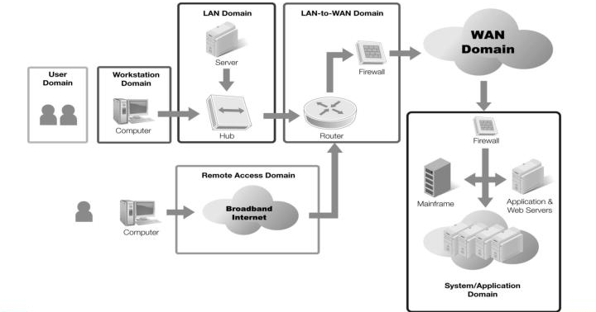
Mapping the IT security policy framework definition to the seven domains of typical IT infrastructure
Identify risks in each domain with solution
https://www.cyberfore.com/post/securing-the-seven-domains-of-it-infrastructure
https://www.domainsprotalk.com/what-are-the-seven-domains-of-a-typical-it-infrastructure/

Slide 19
Mapping the IT security policy framework definition to the seven domains of typical IT infrastructure
User Domain
almost 90% of cyber-attacks caused by human error or behavior , this domain needs strong scrutiny.
Following risks have been identified:
  Employees that fail to lock their computers when getting up from their desks.
  Employees that leave sensitive company information on their desks.
  Limited IT security knowledge by employees can lead to the introduction of malware and social engineering schemes.
  Employee negligence from a lack of policy can lead to legal ramifications for the business.

Slide 20
Mapping the IT security policy framework definition to the seven domains of typical IT infrastructure
Workstation Domain
The Workstation Domain includes any computing devices used by end-users and represents how the users connect to the actual IT infrastructure. The following risks have been identified within this domain:
Old operating systems represent a huge vulnerability. They are beyond their end-of-life and are not maintained with security updates and patches.
Older and outdated hardware is vulnerable to hackers and data loss through outdated firmware exploits and the lack of the ability to encrypt the hardware.
Known remote access vulnerabilities within older OS’s can allow hackers to take over the workstation and gain access to the corporate network.
Old hard drives can lead to failure and the data loss of critical business information.

Slide 21
Mapping the IT security policy framework definition to the seven domains of typical IT infrastructure
LAN Domain
The LAN Domain includes all the equipment that makes up the local area network, including switches, hubs, access points and WiFi, and routers. These devices connect all the workstations to one another. The following risks have been identified within this domain:
Flat network designs lack security.
IT Employees may lack the experience, or the time, in designing and maintaining a secure network.
Lack of security policy governing the network.

Slide 22
Mapping the IT security policy framework definition to the seven domains of typical IT infrastructure
LAN-to-WAN Domain
The LAN-to-WAN Domain is where the corporate LAN connects to the Internet (in this case, the WAN). The Internet is an insecure environment containing many vulnerabilities, but also a necessary component of any business strategy. The following risks can exist in this domain:
No firewall is present, only a simple modem.
Lack of any defensive perimeter controls.
Lack of Intrusion Detection/Intrusion Prevention.

Slide 23
Mapping the IT security policy framework definition to the seven domains of typical IT infrastructure
WAN Domain
The WAN Domain is represented by the Internet and stands for wide area network. All outside entities are represented by this domain, including other businesses, websites, and all external endpoints. The WAN also represents a possible communication channel from an end-user into the LAN utilizing a technology called virtual private networking (VPN), FTP, or Secure Shell (SSH). The following risks exist in this domain:
A lack of security policy and trained employees means multiple vulnerabilities may exist at the perimeter which are unknown, including open ports and protocols, including FTP and Remote Desktop.
Lack of firewalls and possibly improperly configured modem at the perimeter could introduce many possible attacks.

Slide 24
Mapping the IT security policy framework definition to the seven domains of typical IT infrastructure
Remote Access Domain
The Remote Access Domain is represented by any employee, vendor, or contractor that works in the field or from home, instead of within the office environment, and accesses the corporate LAN. Improper set up in this domain can lead to access to the LAN by unauthorized entities, which can turn into a full breach of the network. The following risks exist in this domain:
Weak passwords can lead to unauthorized entry into the network from external locations.
Weak Group Policy on Domain Controller which does not enforce account lockouts, complex passwords, or password history.
Improper set up of VPN, FTP, or other remote access protocol.

Slide 25
Mapping the IT security policy framework definition to the seven domains of typical IT infrastructure
System/Application Domain
The System/Application Domain includes all system and application software-related issues. The software includes anything that collects, accesses, and stores information and can include system software running on servers and application software running on servers and workstations.The following risks have been identified in this domain:
Unpatched operating systems and software existing on the network.
End-users lack of security mindedness and unrestricted workstation access can lead to additional unsupported software being introduced to the network.
An email that is not scanned for viruses.
Employees that are not trained in social engineering schemes can unwittingly open infected files.
Lack of antimalware/antivirus software to protect company assets.

Slide 26
Identifying and Testing Monitoring Requirements
What is infrastructure monitoring?
Infrastructure monitoring is the process of collecting and analyzing data from IT infrastructure, systems, and processes, and using that data to improve business outcomes and drive value across the whole organization.This makes infrastructure monitoring the essence of mission-critical, delivering these key capabilities:
The ability to optimize business requirements and user experience
The flexibility and scalability to ingest data from a variety of sources and to handle planned and unplanned traffic spikes
The ability to detect and alert on outages, resource utilization, and performance degradations to minimize downtime and increase operational efficiency
Pinpoint root causes to determine precisely where a problem originates in the infrastructure or application
The ability to drill down into specific faulty infrastructure components and trigger remediation

Slide 27
Identifying and Testing Monitoring Requirements
Challenges of infrastructure monitoring in cloud environments

Slide 28
Identifying and Testing Monitoring Requirements
What are the benefits of infrastructure monitoring?

Slide 29
Identifying and Testing Monitoring Requirements
What data to use while monitoring IT infrastructure ?
Metrics: Quantitative data is especially useful for creating visualizations and identifying patterns in performance over time.
Event logs: Every system and service generates event logs, which can give you insights into what’s happening and aid in troubleshooting.
Distributed traces: For better insight into how various aspects of your environment interact with one another, capture distributed traces to record the journeys of specific transactions as they make their way through your infrastructure.
Metadata: Additional information, such as topology details, name spaces, and priority data, will help you understand the significance and impact of events as they interact with other components of your infrastructure.
UX data: A view into how users are experiencing your site or applications is one of the most important dimensions to understand how your infrastructure is performing.
Open-source telemetry: There are many open-source options designed to help you achieve better observability across your entire environment. These industry-standard tools include OpenTelemetry , Prometheus, and StatsD, to name a few.
Cloud integrations: Modern infrastructure includes cloud infrastructure, which is why cloud integrations, such as CloudWatch for Amazon Web Services (AWS), can be helpful sources of observability data for infrastructure monitoring.

Slide 30
Identifying and Testing Monitoring Requirements
Infrastructure monitoring best practices
Leverage automation: Augment your capabilities with infrastructure monitoring tools that feature automation.
Configure comprehensive alerts: When your alerts are specific, they’re less likely to result in false positives.
Prioritize alerts: Organize and prioritize notifications so you don’t miss the most important alerts
Create role-specific dashboards: Set up dashboards for your ITOps teams, your security teams, and business leaders so everyone has access to the insights they need at a glance.
Do a test run: Schedule a test run and make sure everything is running according to plan.
Regularly review metrics: As your business goals change and your infrastructure evolves, review them at regular intervals so you don’t unintentionally develop any blind spots across your infrastructure.
Tap your vendor’s expertise: Struggling to fine-tune or optimize your infrastructure monitoring as your organization digitally transforms? Take full advantage of your infrastructure monitoring vendor’s expertise.

Slide 31
What Are Controls and Why Are They Important?
Internal controls are procedures and processes put into place by a company to prevent fraud, promote accountability and ensure the integrity of financial data. Internal controls are unique to every company and designed according to the company's size and structure.
The core purposes of internal controls are to:
Explain the process in which internal controls are carried out
Identify risks
Mitigate risks
Control the sharing of information
Evaluate effectiveness of internal controls

Slide 32
Why Are They (controls) Important?
It establishes the processes
It improves process performance
It improves operational efficiency
It keeps duties separated
It mitigates business risk
It organizes information
It produces timely financial statements
It reduces errors
It improves accountability
It stabilizes operations
It reduces audit fees
Security controls are divided into two categories:
a. goal based
b. implementation based

Slide 33
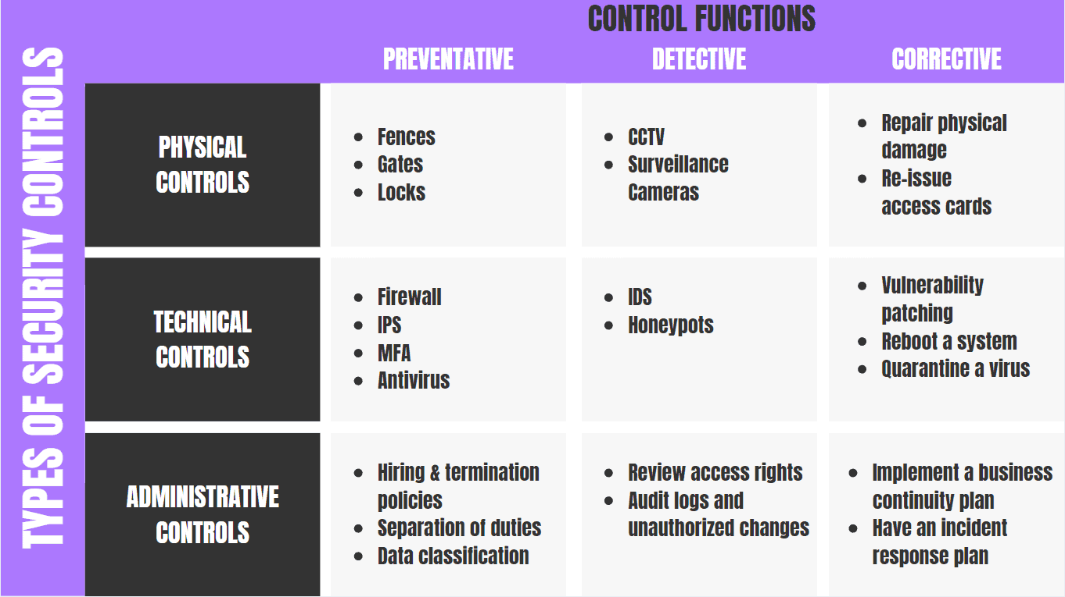
Goal based- Security Controls

Slide 34
Goal based- Security Controls
The overall purpose of implementing security controls as previously mentioned is to help reduce risks in an organization. The common classifications types are listed below along with their corresponding description:
Preventive controls- attempt to prevent an incident from occurring.
Detective controls - attempt to detect incidents after they have occurred.
Corrective controls - attempt to reverse the impact of an incident.
Deterrent controls - attempt to discourage individuals from causing an incident.
Compensating controls - are alternative controls used when a primary control is not feasible.

Slide 35
Implementation based- Security Controls
There are several types of security controls that can be implemented to protect hardware, software, networks, and data from actions and events that could cause loss or damage.
Physical security controls include such things as data center perimeter fencing, locks, guards, access control cards, biometric access control systems, surveillance cameras, and intrusion detection sensors.

Slide 36
Implementation based- Security Controls
Digital security controls include such things as usernames and passwords, two-factor authentication, antivirus software, and firewalls.
Cybersecurity controls include anything specifically designed to prevent attacks on data, including DDoS mitigation, and intrusion prevention systems.
Cloud security controls include measures you take in cooperation with a cloud services provider to ensure the necessary protection for data and workloads. If your organization runs workloads on the cloud, you must meet their corporate or business policy security requirements and industry regulations.

Slide 37
The Security Control Formulation and Development Process
Design & Development of security control:
Why Security Controls?
Imagine that you need to secure your home. Ask yourself,
Why am I securing the home?Very likely, it is because you perceive some threats.
What are the threats to your home? Break-in, theft of valuables, losing your home altogether (hurricane, fire, flood, other), etc.
What happens if the threat materializes? i.e., What is the risk?
What are the first five steps you are likely to take to secure your home to manage the risks you have identified?

Slide 38
The Security Control Formulation and Development Process
The First 5 Steps You Might Take To Secure Your Home
Take stock of your household
Protect the periphery
Restrict further access
Recovery plan if the threat becomes real.
Educate every member of the household

Slide 39
The Security Control Formulation and Development Process
Apply This Thinking To Your IT Security.
1) Take stock – Get to know the expanse of your Information Systems. Take Inventory of your hardware and software.
2) Protect your periphery – List your networks and protect all entry and exit points. (Systems and Network Security Policy)
3) Restrict access – Implement strong passwords, encryption, and role-based access control (identity and Access Control Policy)
4) Prepare for the eventuality – Have a backup and recovery plan that is well documented and, more importantly, well tested. (Backup and Recovery Plan and Incident Response Policy)
5) Awareness and Training – Make sure that each employee/contractor knows what steps are in place for IT security, and their role in maintaining the state of security. (Awareness and Training program)

Slide 40
The Security Control Formulation and Development Process
Examples of security controls
Reference : https://simplicable.com/new/it-security-controls

Slide 41
The Security Control Development Process /Life cycle
Microsoft security development life-cycle(SDL)
https://www.microsoft.com/en-us/securityengineering/sdl/practices

Slide 42
The Security Control Formulation and Development Process
https://www.sciencedirect.com/science/article/abs/pii/S0016003221004919

Slide 43
Control Implementation through Security Architecture Design,
Security architecture - is defined as the architectural design that includes all the threats and potential risks which can be present in the environment or that particular scenario. This also includes the security controls and the use of security controls.

Slide 44
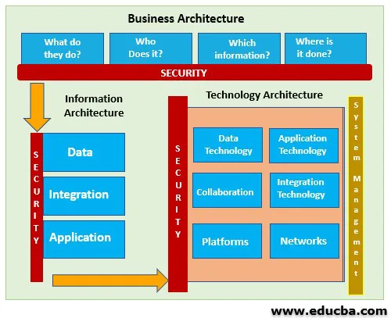
Control Implementation through Security Architecture Design,

